Slide 1
Cohen chap 6. estimation & t
“It is common sense to take a method and try it.
If it fails, admit it frankly and try another.
But above all, try something.”
- Franklin D. Roosevelt
For EDUC/PSY 6600

Slide 2
Problems with z-tests
Small samples
As N ↓, + skewness of sampling distribution of s² ↑
As skewness ↑, s² underestimates σ²
As smaller s² is used in denominator of z-statistic equation, z will ↑, an overestimate
↑ risk of Type I error
Often don’t know σ²
Cannot compute SE_{M}
Can you use s replace σ in SE_{M} and do z-test?
Small samples – No, inaccurate results
Large samples – Yes (>300 participants)
Large samples
s² unbiased estimate of σ² with large N
σ is a constant
s is NOT a constant
Varies from sample to sample
As N increases, s → σ

Slide 3
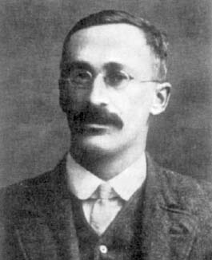
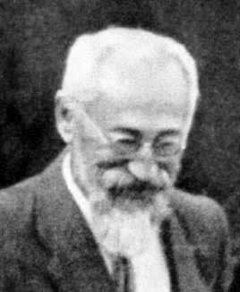
The t-distribution, “student’s t”
1908, William Gosset
Guinness Brewing Company, England
Invented t-test for small samples for brewing quality control
Wrote paper using moniker “a student” discussing nature of SDM when using s² instead of σ²
Worked with Fisher, Neyman, Pearson, and Galton

Slide 4
Student’s t & normal (z) distributions
Similarities
Follows mathematical function
Symmetrical, continuous, bell-shaped
Continues to ± infinity
M = 0
Area under curve = p(event[s])
When N is large (≈ 300), t = z
Differences
Family of distributions
Different distribution for each N (or df)
Larger area in tails (%) for any value of t corresponding to z
t_{crit} will be larger than z_{crit}, for a given α
More difficult to reject H₀ w/ t-distribution
df = N - 1
As df ↑: critical value of t → z

Slide 5
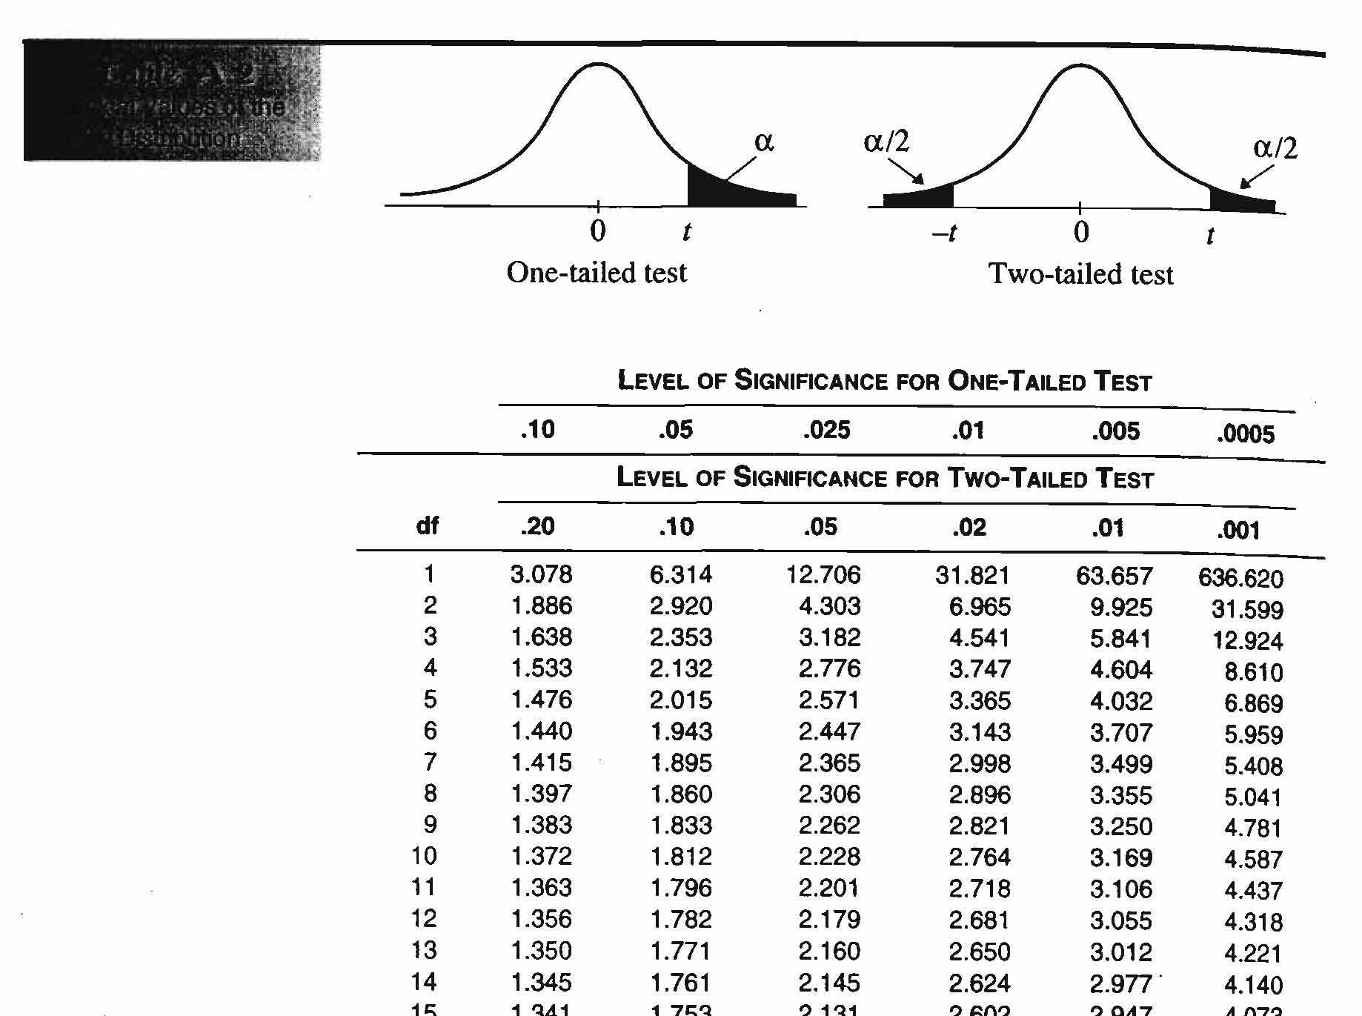
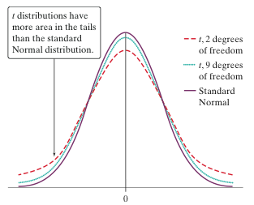
The t-table

Slide 6
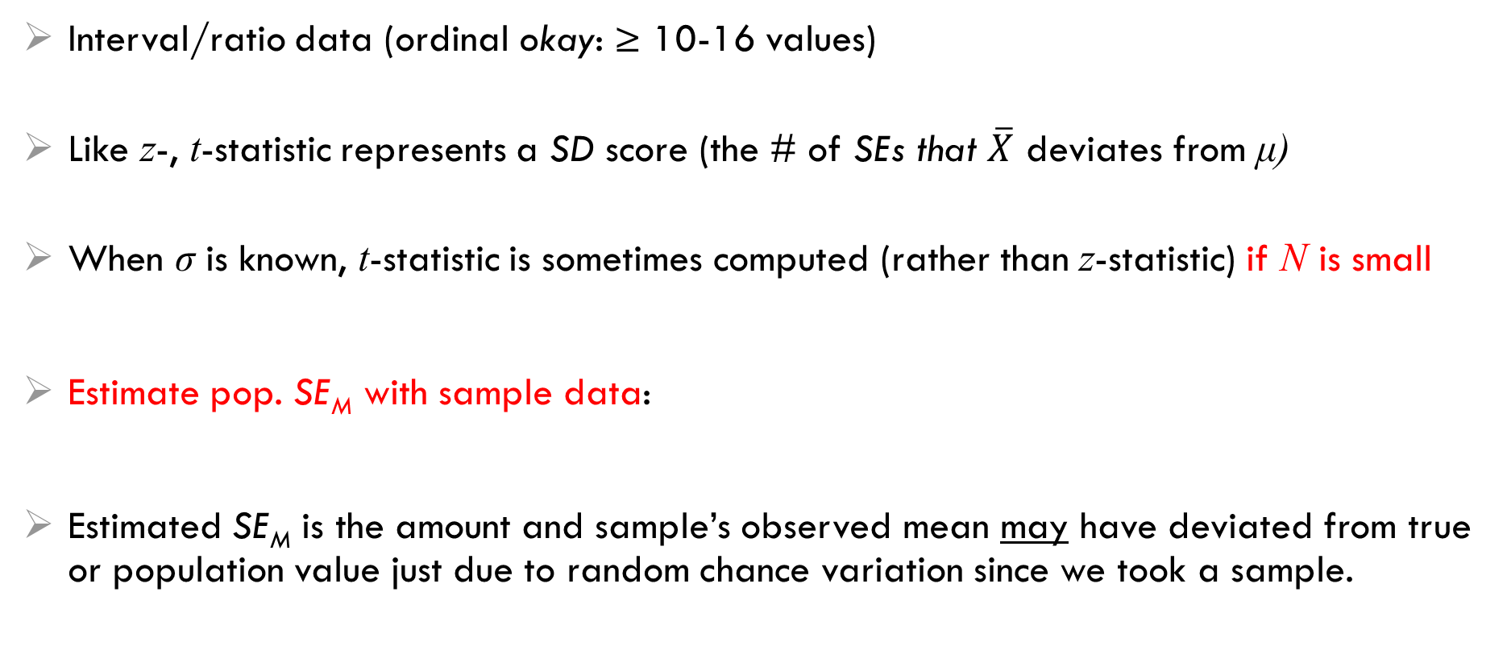
Calculating the t-statistic
Interval/ratio data (ordinal okay: ≥ 10-16 values)
Like z-, t-statistic represents a SD score (the # of SEs that $\overline{X}$ deviates from μ)
When σ is known, t-statistic is sometimes computed (rather than z-statistic) if N is small
Estimate pop. SE_{M} with sample data:
Estimated SE_{M} is the amount and sample’s observed mean may have deviated from true or population value just due to random chance variation since we took a sample.

Slide 7
Assumptions (same as z tests)
Sample was drawn at random (at least as representative as possible)
Nothing can be done to fix NON-representative samples!
Can not statistically test
SD of the sampled population = SD of the comparison population
Very hard to judge
Can not statistically test
Variables have a normal distribution
Not as important if the sample is large (Central Limit Theorem)
IF the sample is far from normal &/or small n, might want to transform variables
Look at plots: histogram, boxplot, & QQ plot (straight 45º line) ← sensitive to outliers!!!
Skewness & Kurtosis: Divided value by its SE & > ± 2 indicates issues
Shapiro-Wilks test (small N): p < .05 → not normal
Kolmogorov-Smirnov test (large N):

Slide 8
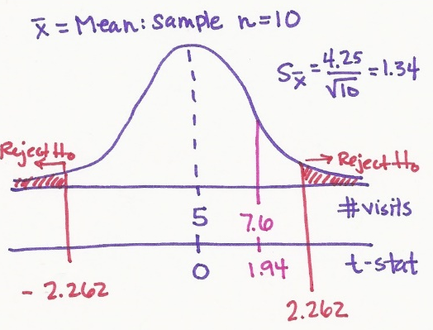
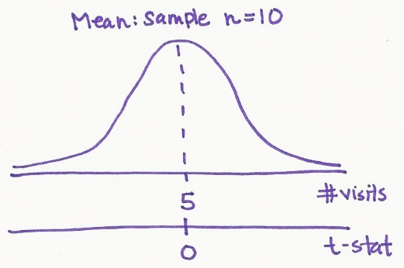
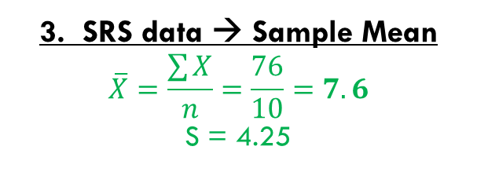
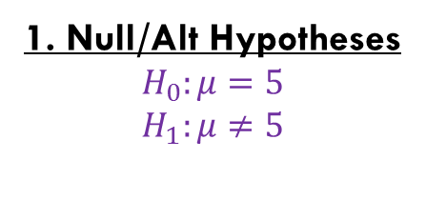
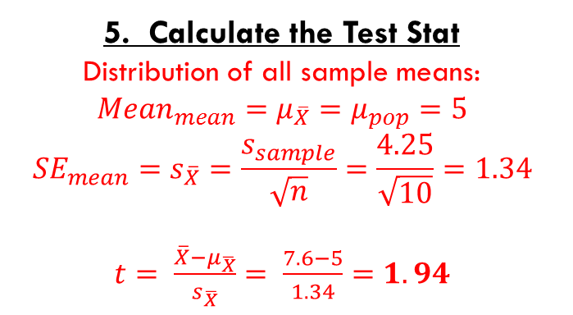
Example: 1-sample t-test
A physician states that, in the past, the average number of times he saw each of his patients during the year was 5. However, he believes that his patients have visited him significantly more frequently during the past year. In order to validate this statement, he randomly selects 10 of his patients and determines the # of office visits during the past year. He obtains the values presented to the below.
9, 10, 8, 4, 8, 3, 0, 10, 15, 9
Do the data support his contention that the average number of times he has seen a patient in the last year is different than 5?
4. Rejection Region?
df = n – 1 = 10 – 1 = 9
Critical t = +/- 2.262 …
Reject if t-score is >2.262 or < -2.262
1. Null/Alt Hypotheses
$$H_{0}:μ=5$$
$$H_{1}:μ≠5$$
6. Conclusion
t-stat does NOT falls in the rejection region
No evidence the population’s mean is not 5
“FAIL to reject the Null”
“Even though this sample’s mean of 7.6 was more than 5, this could be due to random chance and another sample may find the opposite effect.”
2. Choose Test Stat, α, & # tails
CLT: mean of repeated SRS → normally dist. w/o pop SD known
→ So use the t-stat
α = .05 & 2 tails (default)
5. Calculate the Test Stat
Distribution of all sample means:
$${Mean}_{mean}=μ_{\overline{X}}=μ_{pop}=5$$
$${SE}_{mean}=s_{\overline{X}}=\frac{s_{sample}}{\sqrt{n}}=\frac{4.25}{\sqrt{10}}=1.34$$
$t= \frac{\overline{X}−μ_{\overline{X}}}{s_{\overline{X}}}= \frac{7.6−5}{1.34}=1.94$
3. SRS data → Sample Mean
$$\overline{X}=\frac{\sum{X}}{n}=\frac{76}{10}=7.6$$
S = 4.25

Slide 9
Confidence intervals
Statistics are point estimates, or population parameters, with error
How close is estimate to pop. parameter?
Confidence interval (CI) around point estimate (Range of values)
Confidence limits (CL)
Values that bound CI
Upper limit: UL or UCL
Lower limit: LL or LCL
CI expresses our confidence in a statistic & the width depends on SE_{M} and t_{crit}
Both are function of N
Larger N → Smaller CI
More confident that sample point estimate (statistic) approximates population parameter
Narrow CI → Less confidence, more precision (less error)
Wide CI → More confidence, less precision (more error)

Slide 10
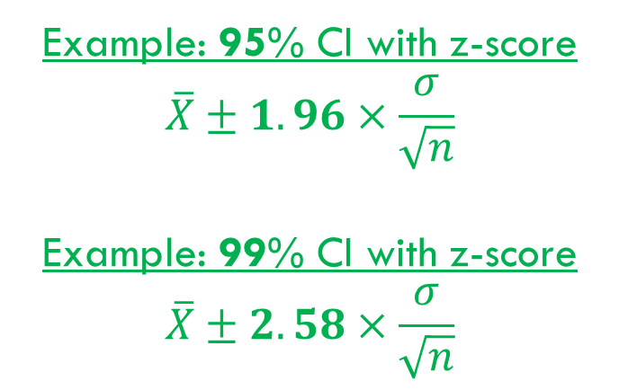
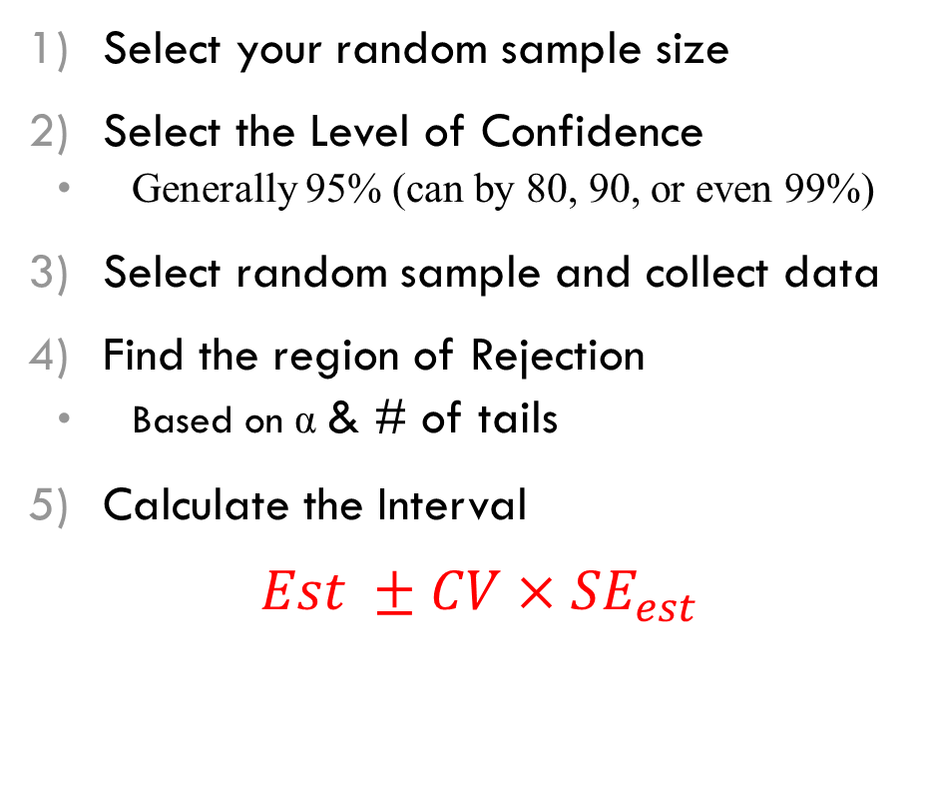
Steps to construct a Confidence interval
Narrow CI
Large N
Lower %
Wider CI
smaller N
Higher %
Select your random sample size
Select the Level of Confidence
Generally 95% (can by 80, 90, or even 99%)
Select random sample and collect data
Find the region of Rejection
Based on α & # of tails
Calculate the Interval
$Est ±CV×{SE}_{est}$
Example: 95% CI with z-score
$$\overline{X}±1.96×\frac{σ}{\sqrt{n}}$$
Example: 99% CI with z-score
$$\overline{X}±2.58×\frac{σ}{\sqrt{n}}$$

Slide 11
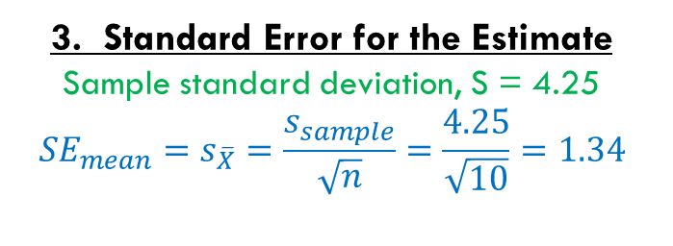
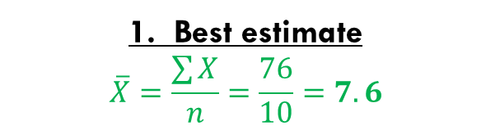
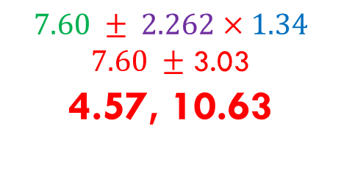
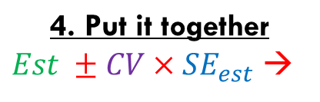
Example: Confidence interval for the mean
A physician states that, in the past, the average number of times he saw each of his patients during the year was 5. However, he believes that his patients have visited him significantly more frequently during the past year. In order to validate this statement, he randomly selects 10 of his patients and determines the # of office visits during the past year. He obtains the values presented to the below.
9, 10, 8, 4, 8, 3, 0, 10, 15, 9
Construct a 95% confidence interval for the mean number of visits per patient.
1. Best estimate
$$\overline{X}=\frac{\sum{X}}{n}=\frac{76}{10}=7.6$$
2. Critical Value
df = n – 1 = 10 – 1 = 9
Always use TWO tails
Critical t = 2.262
3. Standard Error for the Estimate
Sample standard deviation, S = 4.25
$${SE}_{mean}=s_{\overline{X}}=\frac{s_{sample}}{\sqrt{n}}=\frac{4.25}{\sqrt{10}}=1.34$$
$$\text{4}\text{.} \text{Put} \text{it} \text{together}$$
$Est ±CV×{SE}_{est}$ →
$$7.60 ± 2.262×1.34$$
$7.60 ±$ 3.03
4.57, 10.63

Slide 12
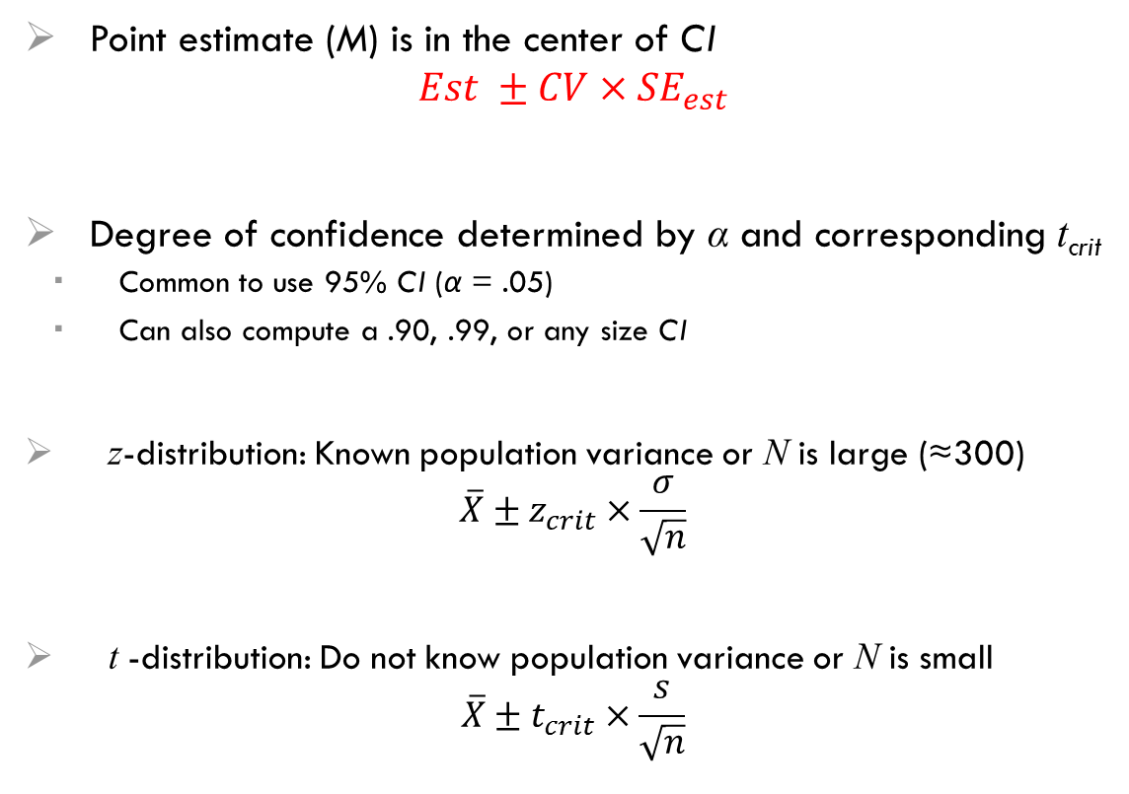
Estimating the population mean
NOT the meaning of a 95% CI
There is NOT a 95% chance that the population M lies between the 2 CLs from your sample’s CI !!!
Each random sample will have a different CI with different CLs and a different M value
Point estimate (M) is in the center of CI
$$Est ±CV×{SE}_{est}$$
Degree of confidence determined by α and corresponding t_{crit}
Common to use 95% CI (α = .05)
Can also compute a .90, .99, or any size CI
z-distribution: Known population variance or N is large (≈300)
$$\overline{X}±z_{crit}×\frac{σ}{\sqrt{n}}$$
t -distribution: Do not know population variance or N is small
$$\overline{X}±t_{crit}×\frac{s}{\sqrt{n}}$$
Meaning of a 95% CI
95% of the CIs that could be constructed over repeated sampling will contain Μ
Yours MAY be one of them
5% chance our sample’s 95% CI does not contain μ
Related to Type I error

Slide 13
Bootstrapped Confidence intervals
Avoids assuming that your variable is normally distributed
Computer-intensive…not by hand!
Easy as pie for SPSS
Basic Idea:
Draw a random sample from your sample (with replacement) ← some may be chosen multiple times or no times
compute this sample’s mean, SD, and t-score
repeat 1 & 2 lots of times, like 1,000+ (this is the not-by-hand part ;)
Use the set of t-scores (1,000+ of them) & see where the original t-score falls in the distribution
IBM SPSS has removed the bootstrap option from the basic software and now only offers it at additional cost (more than $1000/yr)
Do NOT worry about bootstrapping for this class

Slide 14
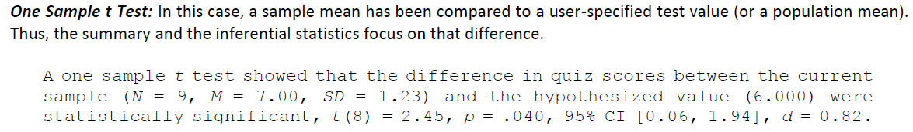
APA: results of a 1-sample z-test
Z-test (happens to be a statistically significant difference):
The hourly fee (M = $72) for our sample of current psychotherapists is significantly greater, z = 4.0, p < .001, than the 1960 hourly rate (µ = $63, in current dollars).
T-test (happens to not quite reach .05 significance level):
Although the mean hourly fee for our sample of current psychotherapists was considerably higher (M = $72, SD = 22.5) than the 1960 population mean (µ = $63, in current dollars), this difference only approached statistical significance, t(24) = 2.00, p = .06.

Slide 15
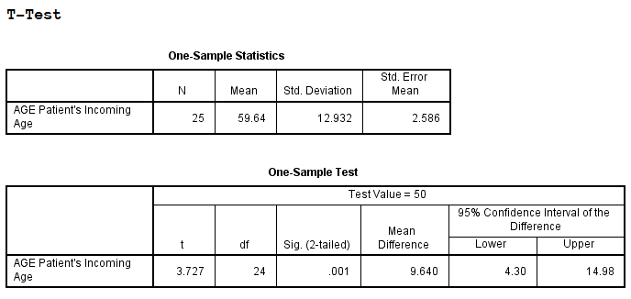
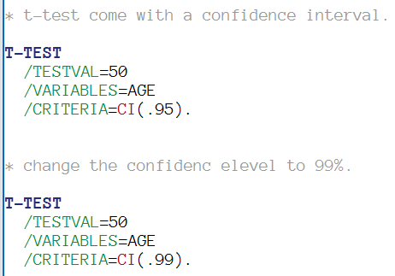
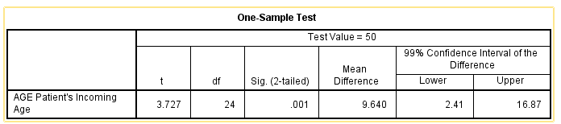
SPSS: perform a 1-sample t-test & CI

